Slide 1
Battle of Finding the Similar Neighbourhood

Slide 2
Introduction
A friend of mine is moving from New York City (Brooklyn) to Toronto (Canada).
He is searching for a place in Toronto which is similar in neighbourhood as in Brooklyn (New York City).
As he is moving to Toronto he asked me to help him in finding a place which has same surrounding like malls, bar, restaurants, gym etc. nearby to his new place.

Slide 3
Data Acquisition and Cleaning
New York City neighbourhood has a total of 5 boroughs and 306 neighbourhoods in order to segment the neighbourhood and explore them we need a dataset. The data set is available free available at :
https://geo.nyu.edu/catalog/nyu_2451_34572 (json file).
For the Toronto neighbourhood data, a Wikipedia page exists that has all the information we need to explore and cluster the neighbourhoods in Toronto. You will be required to scrape the Wikipedia page and wrangle the data, clean it, and then read it into a pandas data frame so that it is in a structured format like the New York dataset.

Slide 4
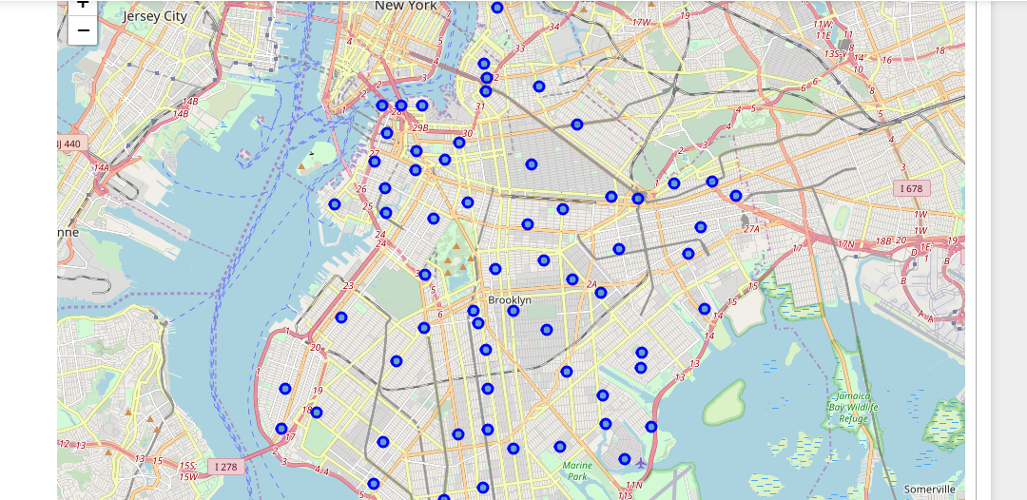
Methodology
In order to get the accurate Brooklyn neighbourhood segmentation we create a map marking all the neighbourhoods of Brooklyn.

Slide 5
Access Foursquare location data of each neighbourhoods, using one hot technique to get top 20 venues of Brooklyn’s neighbourhood.
Apply K-means Cluster to segment all 70 neighbourhoods of Brooklyn into 5 clusters.

Slide 6
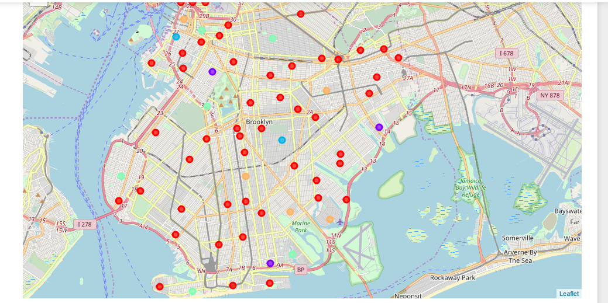

Slide 7
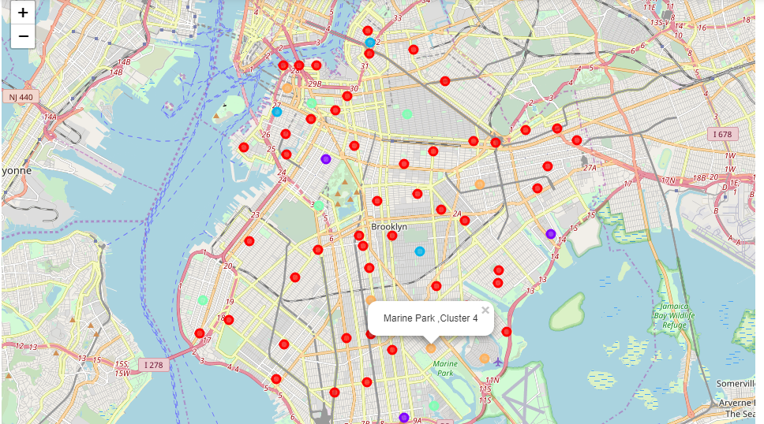
As he lives in Marine Park (Cluster 4)

Slide 8
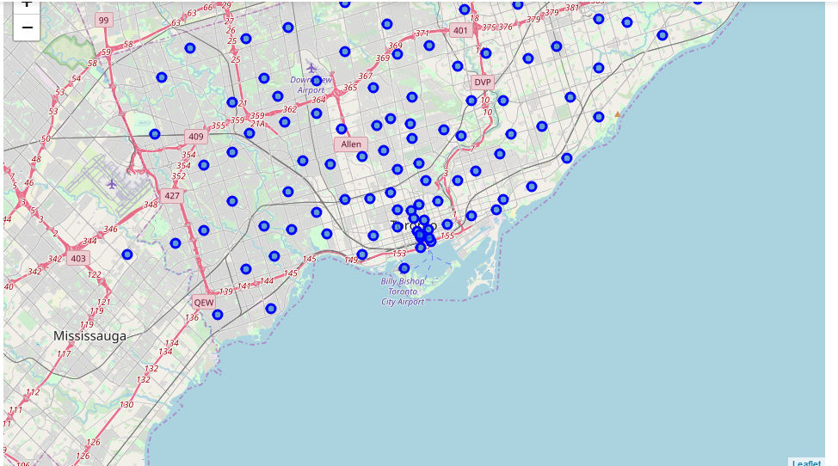
Now we repeated the process for Toronto having 103 neighbourhood.

Slide 9
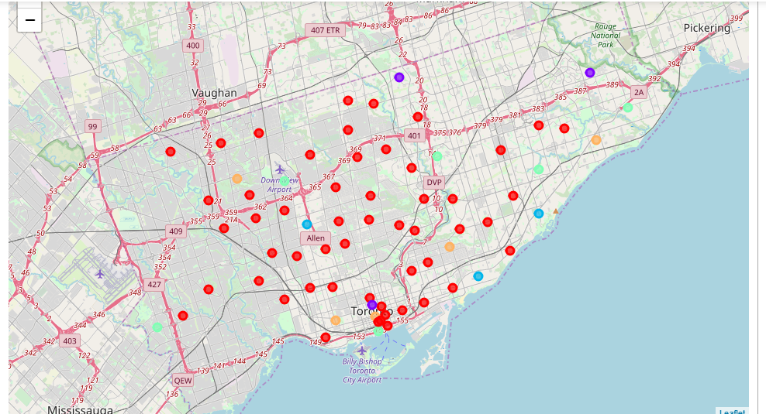

Slide 10
Result
In New York City Marine Park falls under cluster 4. So in Toronto 4 Boroughs namely North York, Etobicoke, East York , Central Toronto falls in Cluster 4 showing similar neighbourhood as Marine Park in Brooklyn.

Slide 11
Discussion
The neighbourhoods of cluster 4 in Toronto are very much similar to Marine Park in New York City. So finally we have four choices out of 103 neighbourhoods of Toronto. Thus making our search limited to these four neighbourhoods only in place of searching in 103 neighbourhoods.

Slide 12
Conclusion
This result has limitations. The venues used in the project are from the top 20 venues of each neighbourhood, which might neglect neighbourhoods with more venues

